Slide 1









Hotels Reservations
Analysis

Slide 2




OUR
TEAM
Haitham Khair
Ahmed Nabil
Mohamed Sadiq
Roaa Gaber

Slide 3




CONTENT
INTRODUCTION
DWH DESIGN
DATABASE DESIGN
DWH DESIGN
ETL PROCESS
ANALYZING DATA

Slide 4




INTRODUCTION
Our project focuses on analyzing hotel reservation data, utilizing a comprehensive dataset from Kaggle. It explores key trends in booking behaviors, cancellations, customer profiles, and seasonal demand. With 5 CSV files covering diverse aspects of hotel operations, this analysis offers valuable insights to enhance revenue strategies and customer satisfaction
Hotels Reservations
Analysis

Slide 5




DATABASE DESIGN
01
Data Collection
02
Understanding the data
03
Data Cleaning
01
04
Design entity relation diagram ( ERD )
05
Modeling and Mapping
06
Creating Data Base Using SQL
06
07
Transferring the data into SQL
07

Slide 6

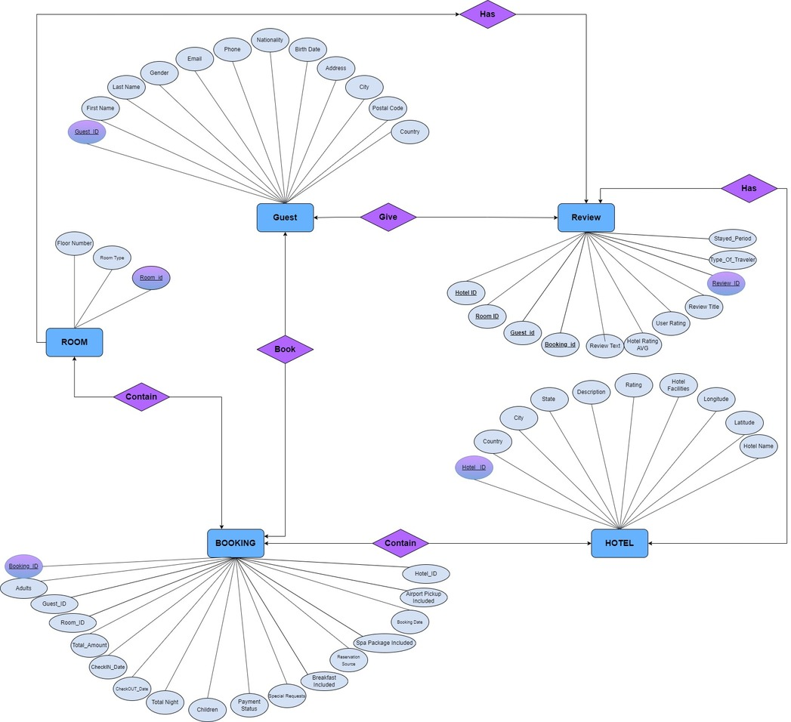
ERD

Slide 7
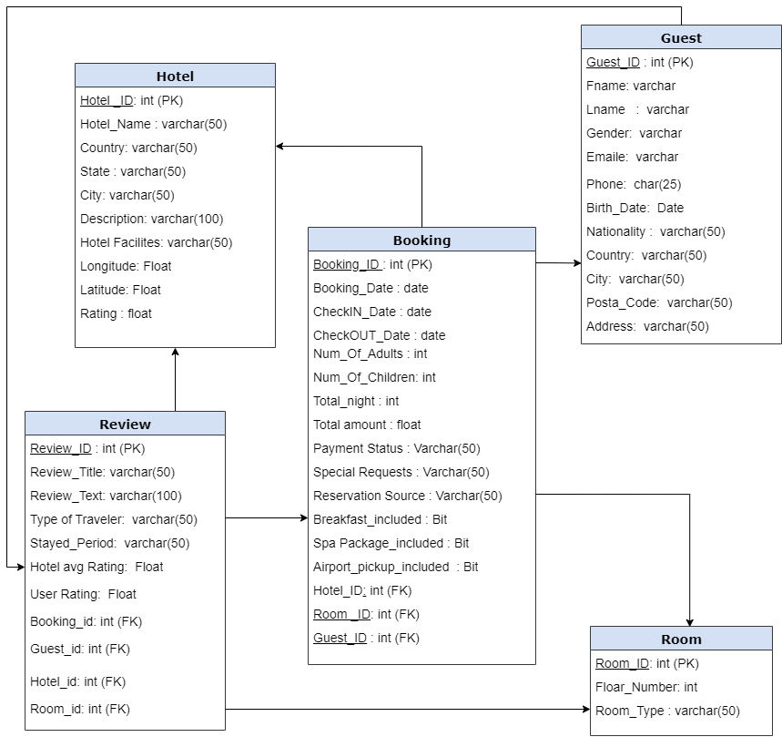
DATABASE MAPPING

Slide 8

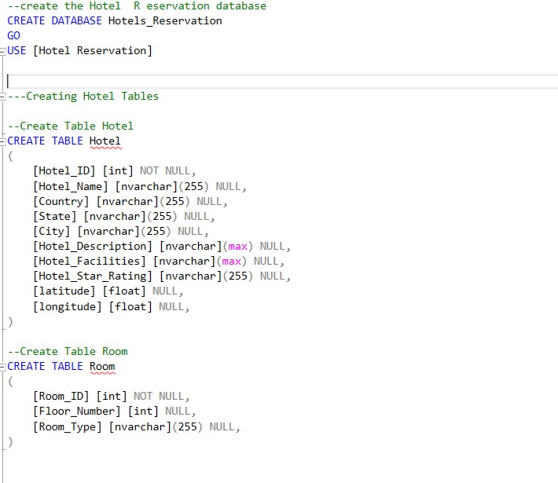
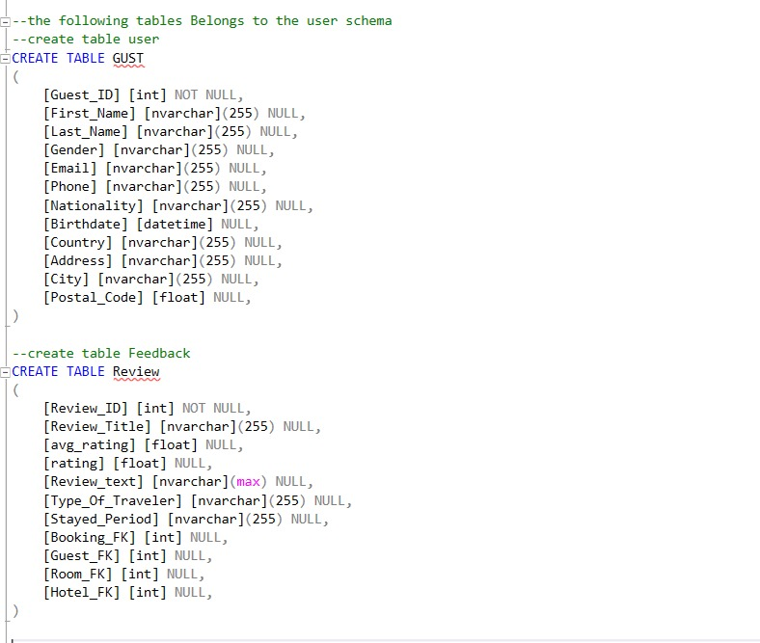
DATABASE IMPLEMENTAION

Slide 9
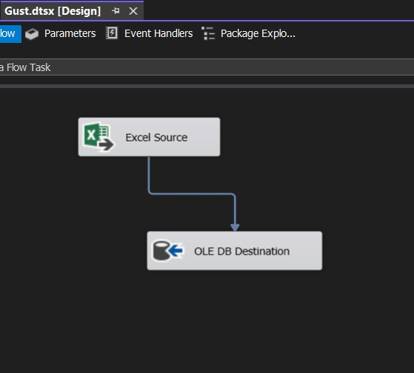
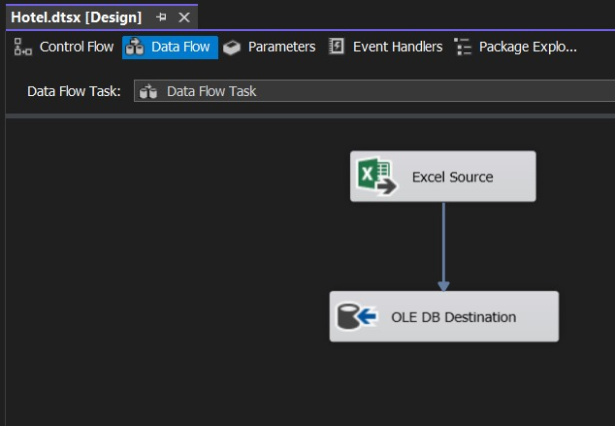
ETL for Database
01
FACT
06
07

Slide 10

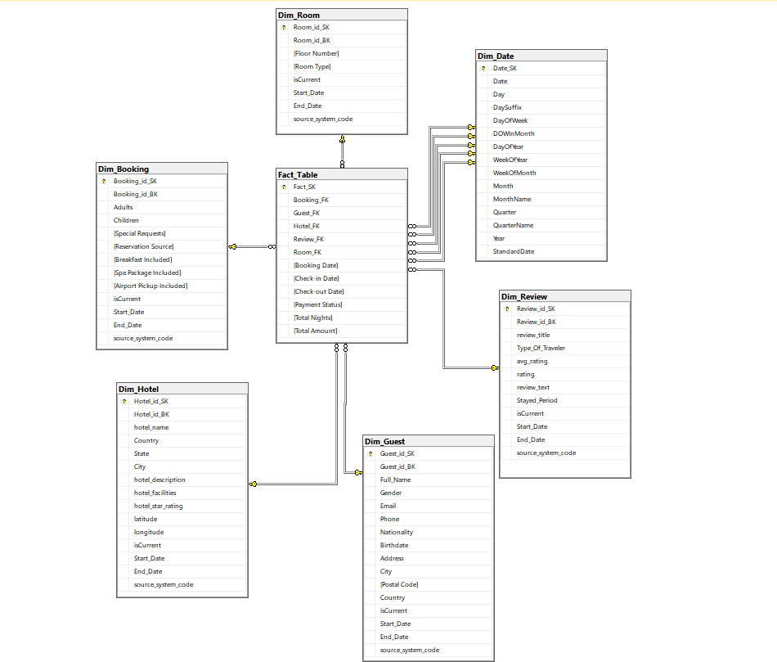
Star Schema

Slide 11







ETL Process overview
An ETL (Extract, Transform, Load) process was implemented. So We could transform the data from Database into a Data Warehouse. The following tables were created in the DWH to organize the data:
ROOM_DIM
BOOKING_DIM
HOTEL_DIM
01
FACT
GUEST_DIM
REVIEW_DIM
06
DATE_DIM
07

Slide 12
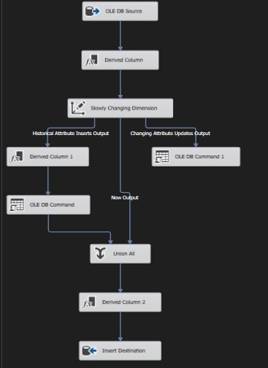
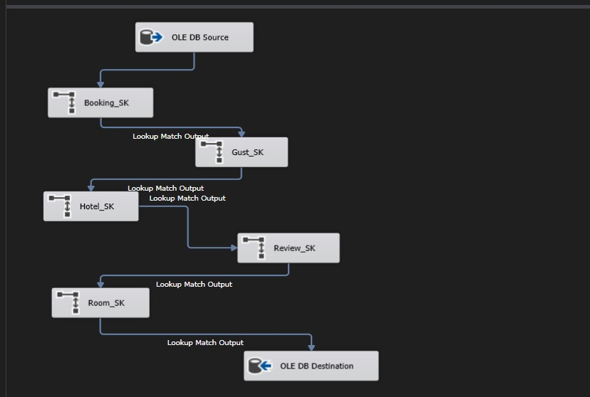
ETL Process
01
FACT
06
07

Slide 13

ANALYZING DATA
inspects, cleans, transforms, and models data to extract insights and support decision-making
01
06
07

Slide 14





ANALYSIS TOOLS
SSAS
SSRS
FACT
POWER BI
06
TABLEAU
07

Slide 15

SSAS
create OLAP cubes, defining dimensions and measures for efficient data analysis. Enabled fast, multidimensional querying
01
06
07

Slide 16
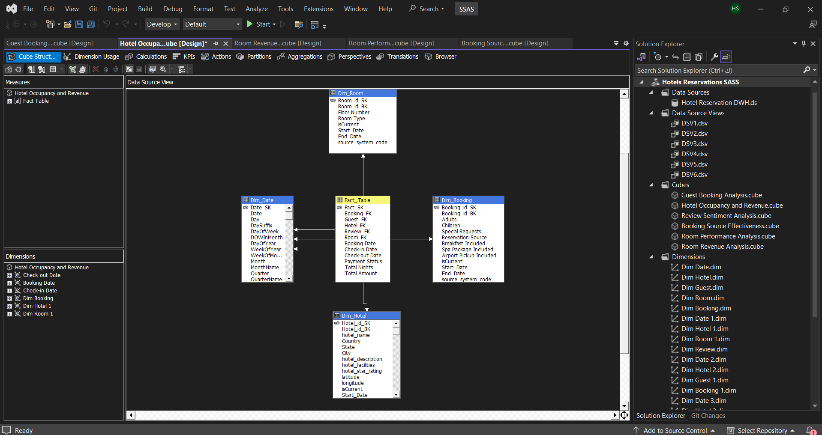
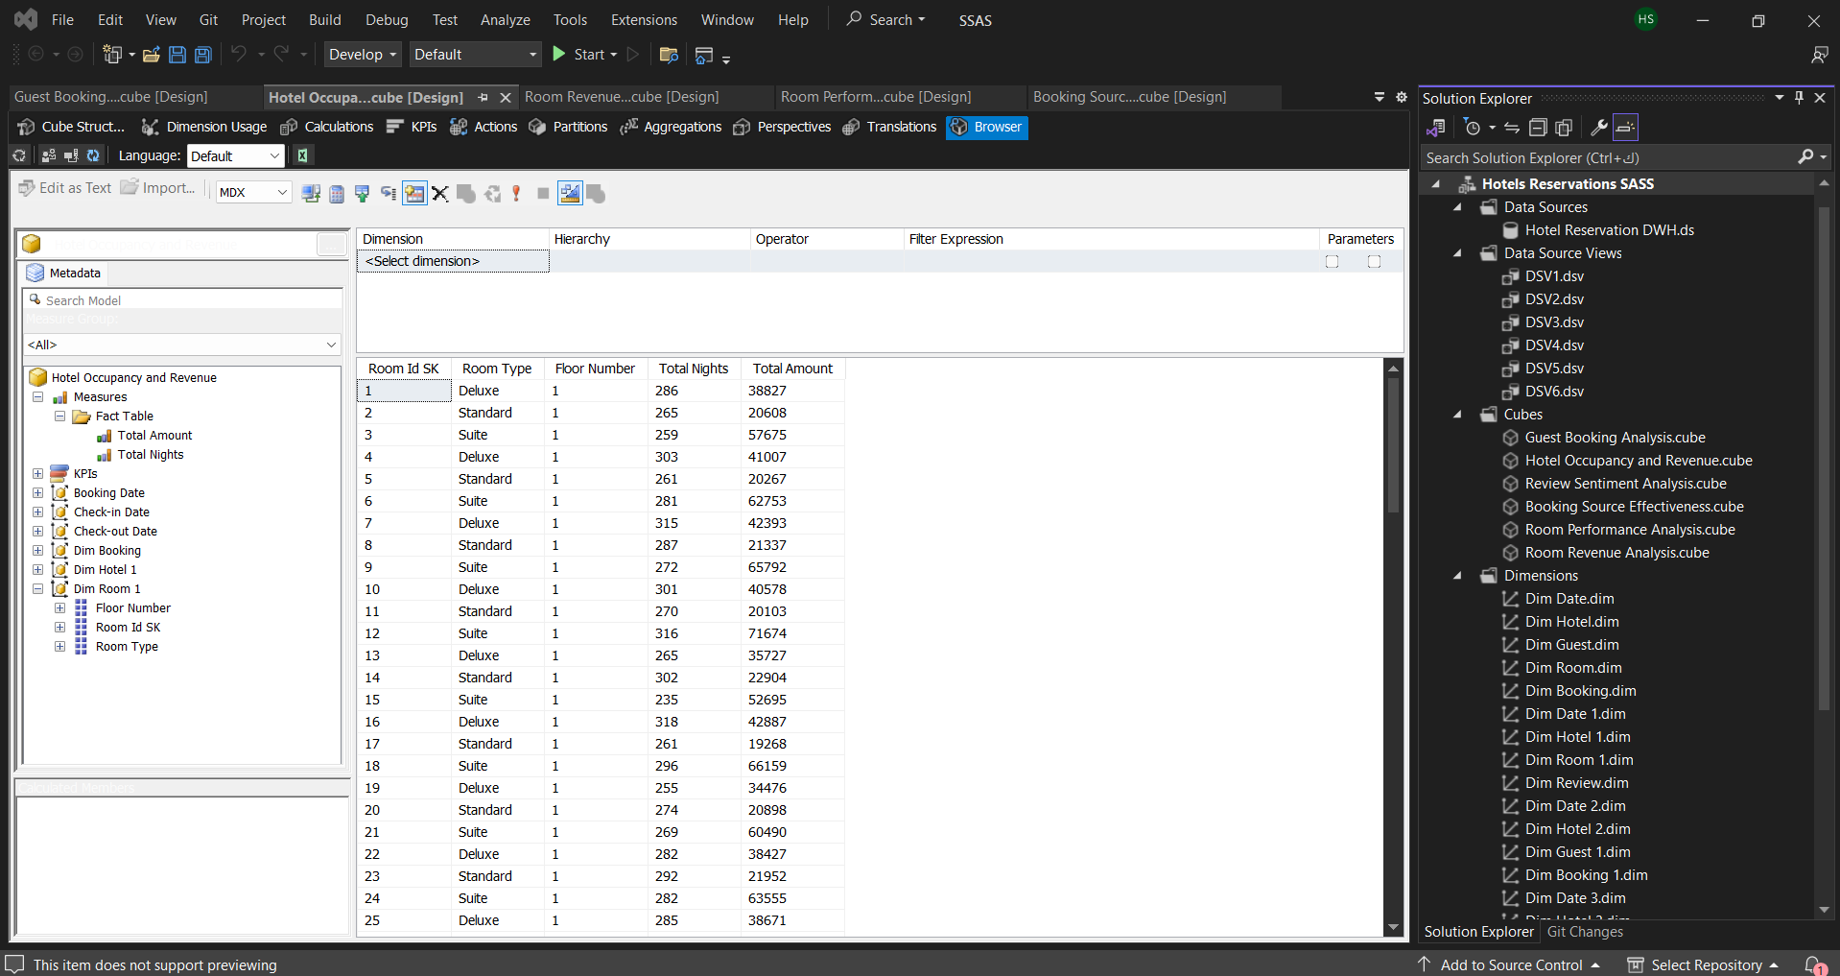
CUBE (1)
01
FACT
06
07

Slide 17
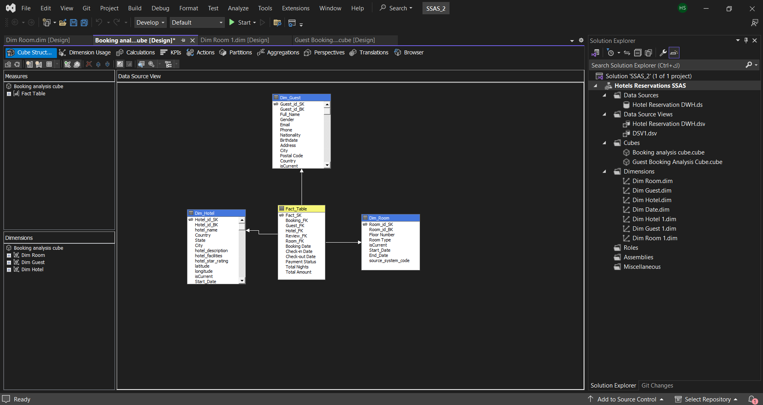
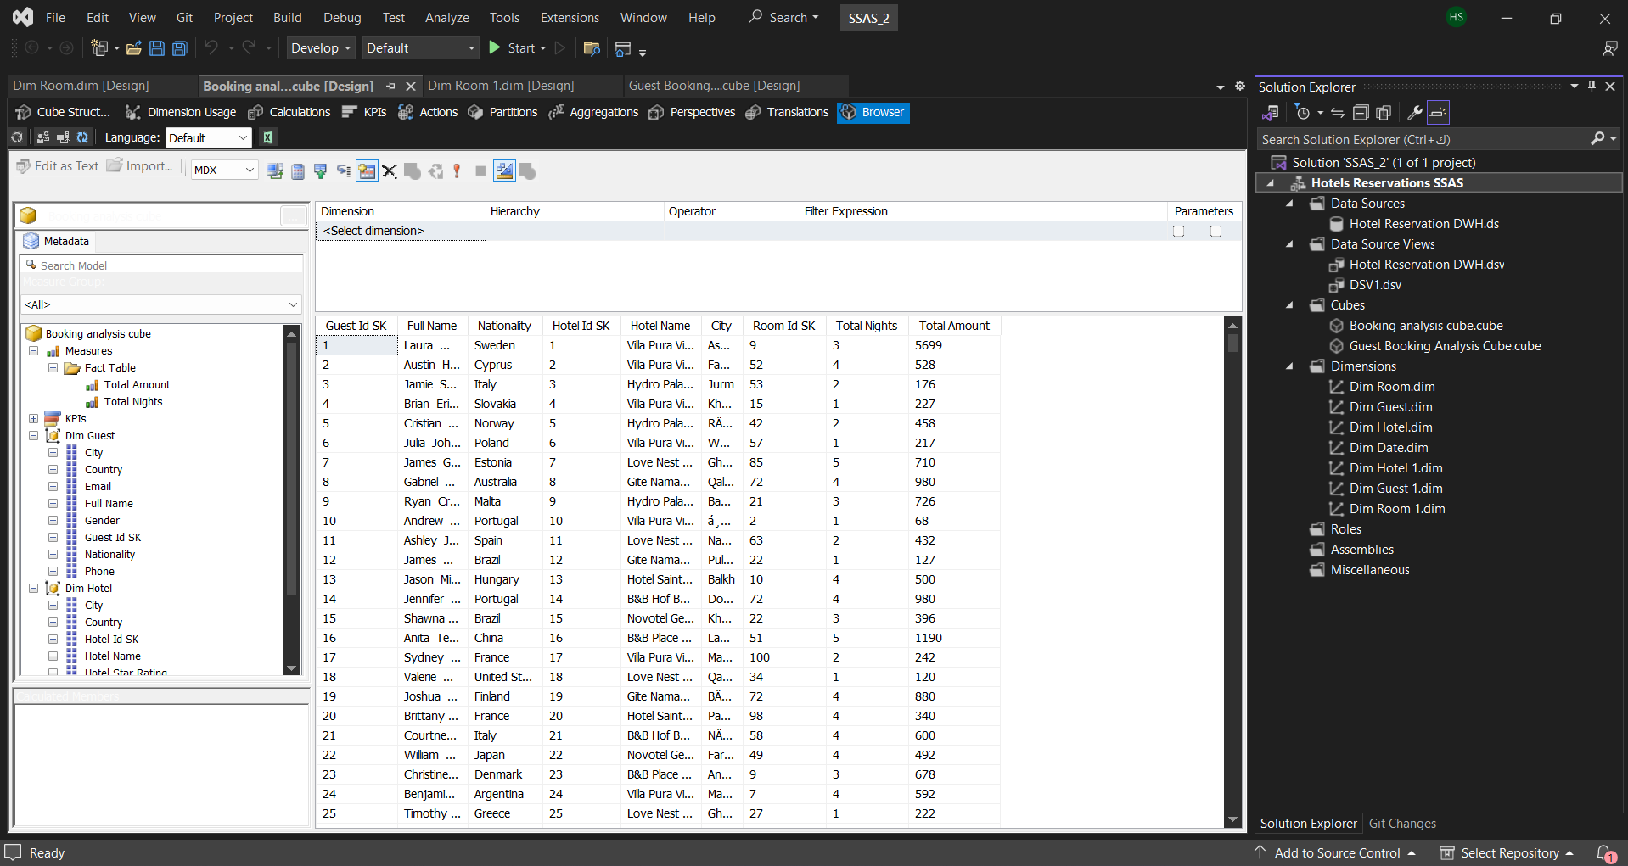
CUBE (2)
01
FACT
06
07

Slide 18

SSRS
designed and developed interactive reports, leveraging parameters and expressions for dynamic data visualization. Ensured seamless integration with databases to deliver real-time insights to stakeholders.
01
06
07

Slide 19
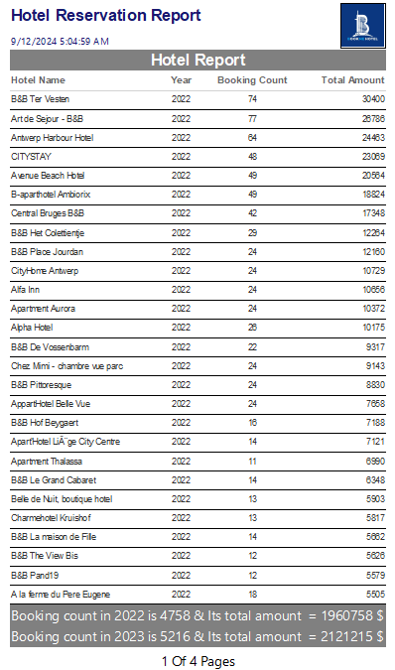
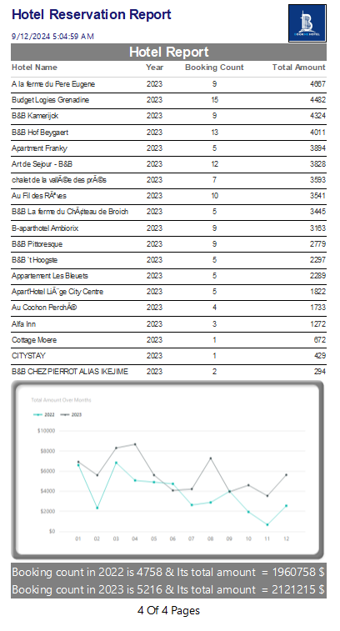
HOTEL REPORT
01
FACT
06
07

Slide 20
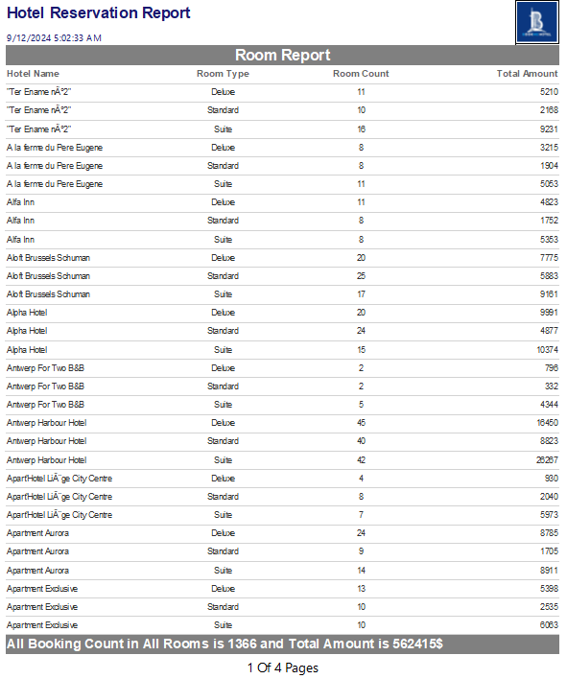
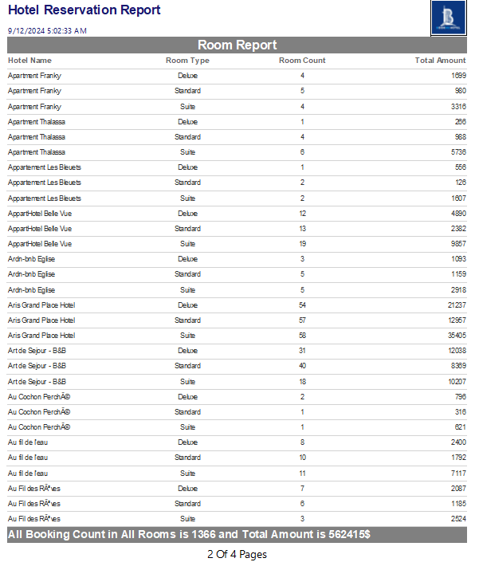
ROOM REPORT
01
FACT
06
07

Slide 21
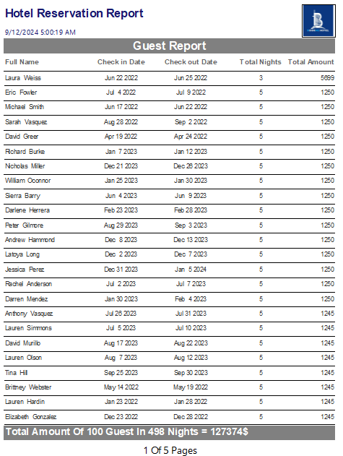
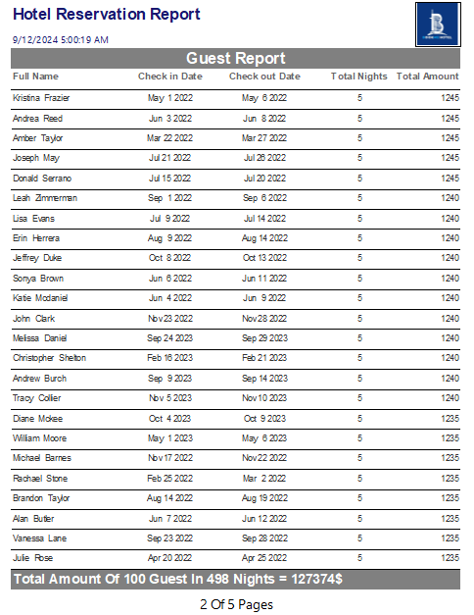
GUEST REPORT
01
FACT
06
07

Slide 22
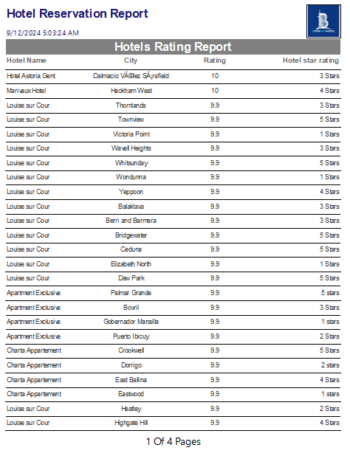
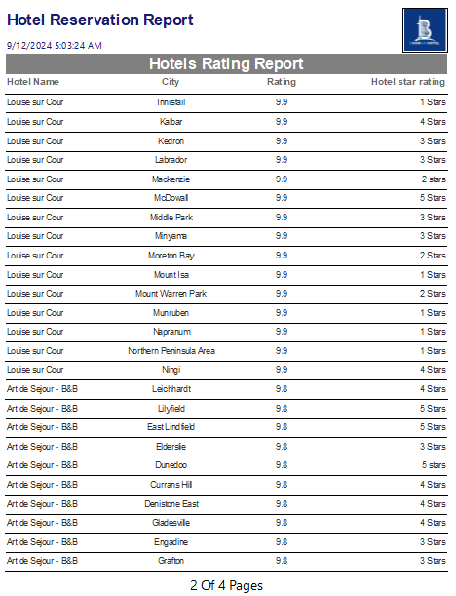
REVIEW REPORT
01
FACT
06
07

Slide 23

POWER BI
built interactive dashboards and reports, utilizing DAX for advanced calculations and data modeling. Enabled real-time insights through seamless integration with various data sources.
01
06
07

Slide 24
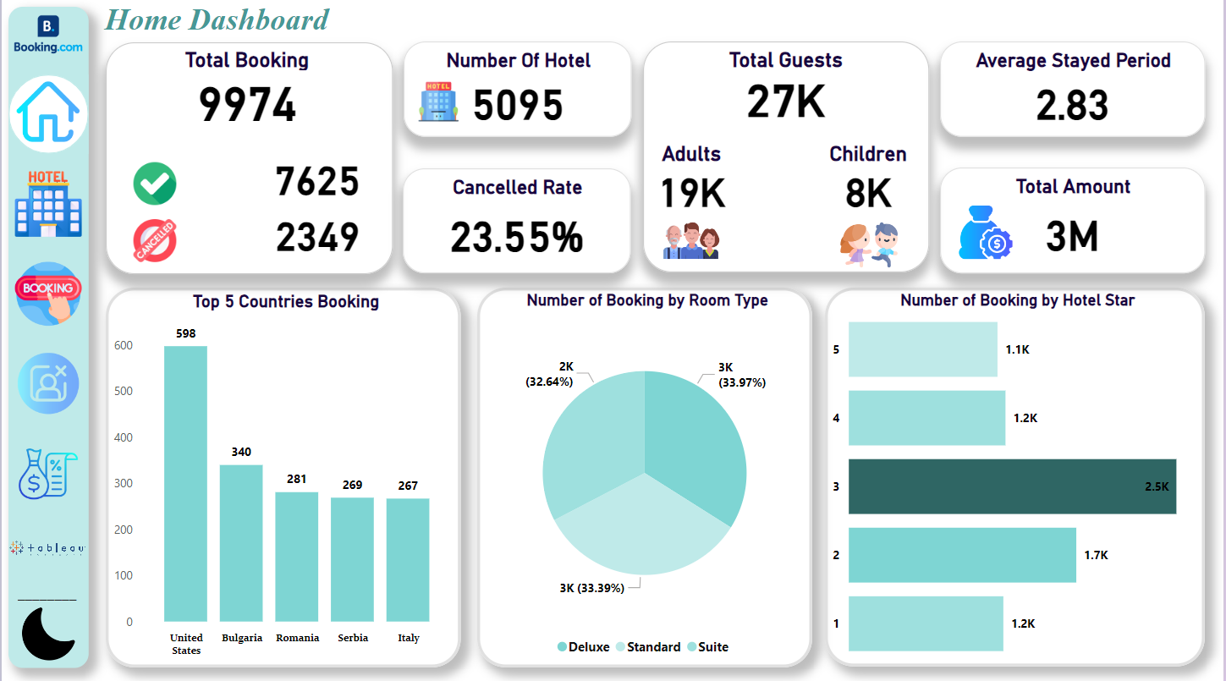
Home DASHBOARD (LM)
01
FACT
06
07

Slide 25
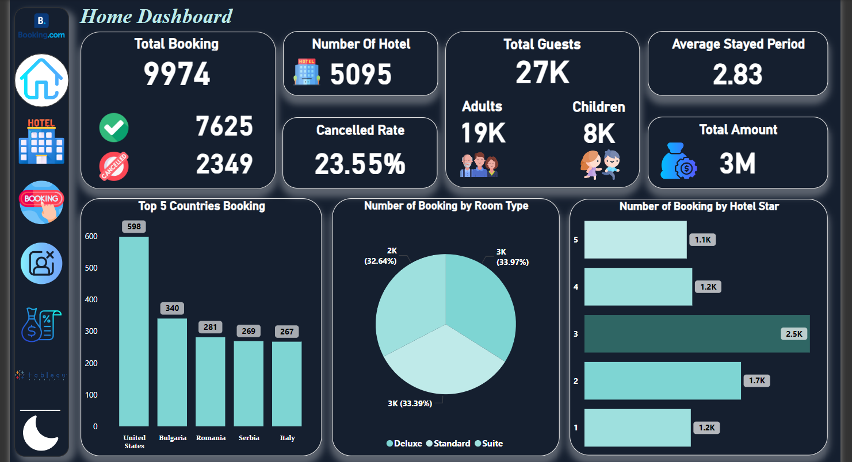
Home DASHBOARD (DM)
01
FACT
06
07

Slide 26
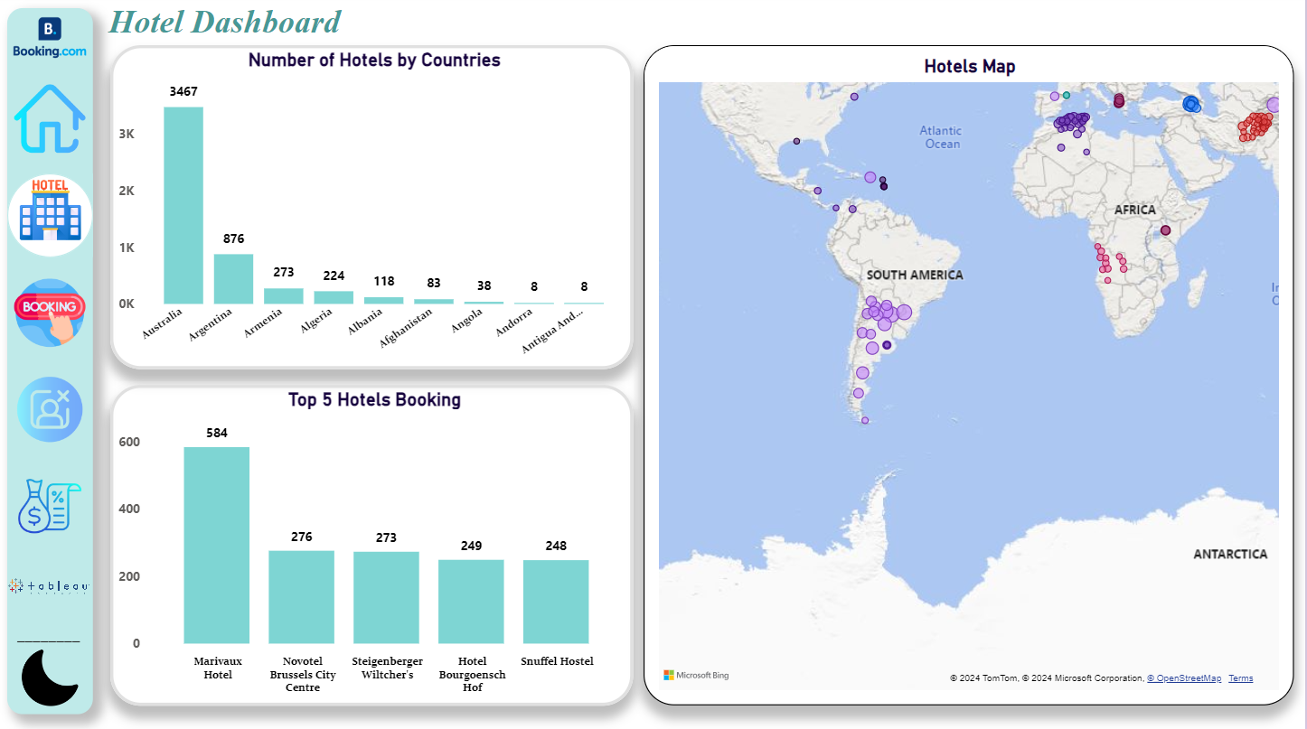
Hotel DASHBOARD (LM)
01
FACT
06
07

Slide 27
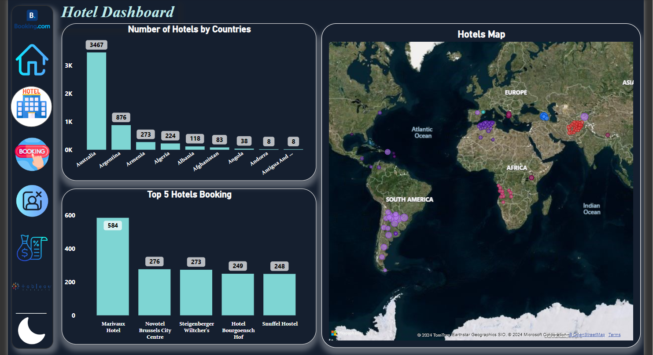
Hotel DASHBOARD (DM)
01
FACT
06
07

Slide 28
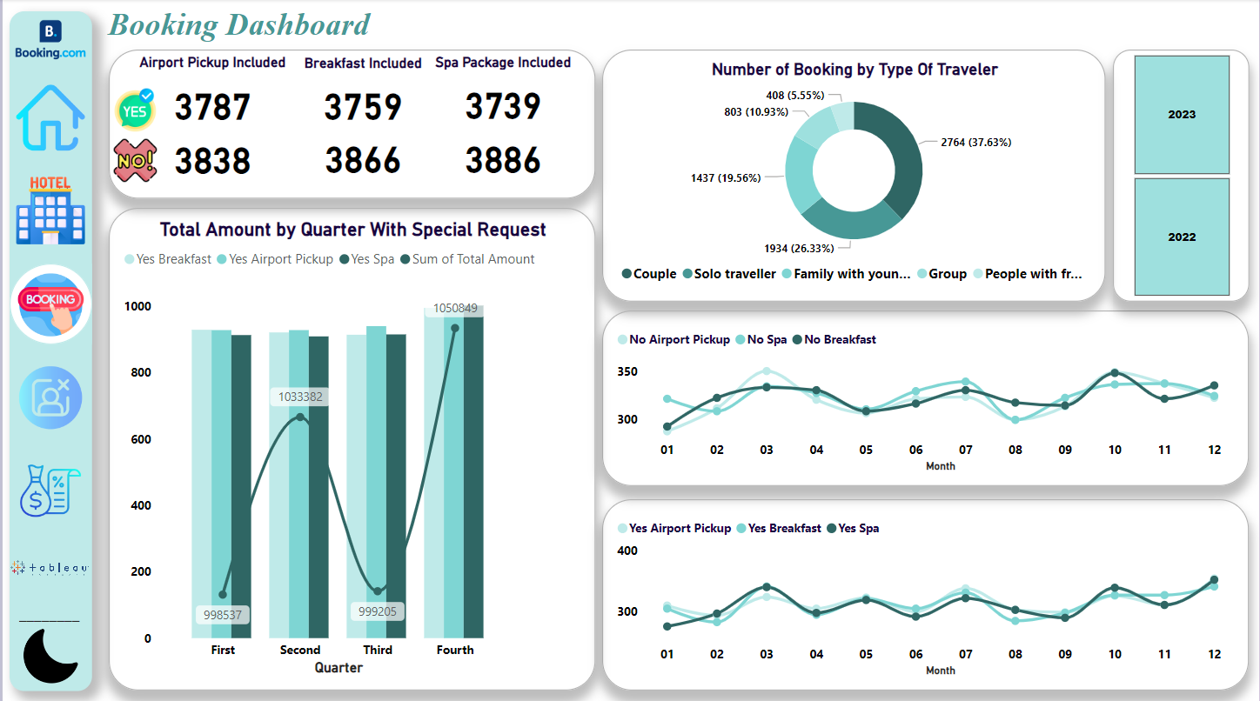
BOOKING DASHBOARD (LM)
01
FACT
06
07

Slide 29
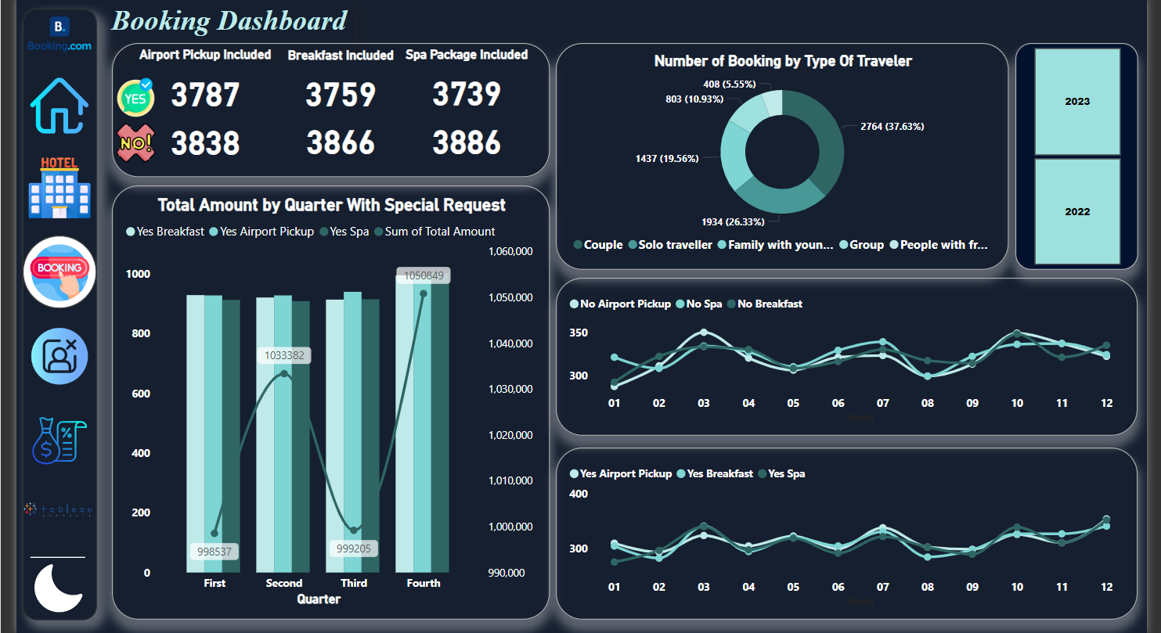
BOOKING DASHBOARD (DM)
01
FACT
06
07

Slide 30
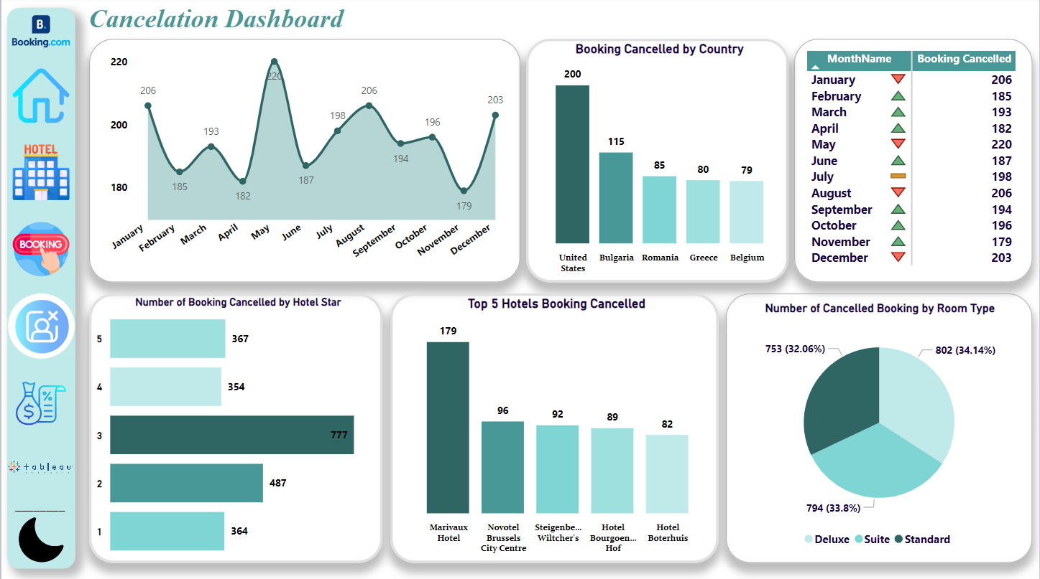
CANCELATION DASHBOARD (LM)
01
FACT
06
07

Slide 31
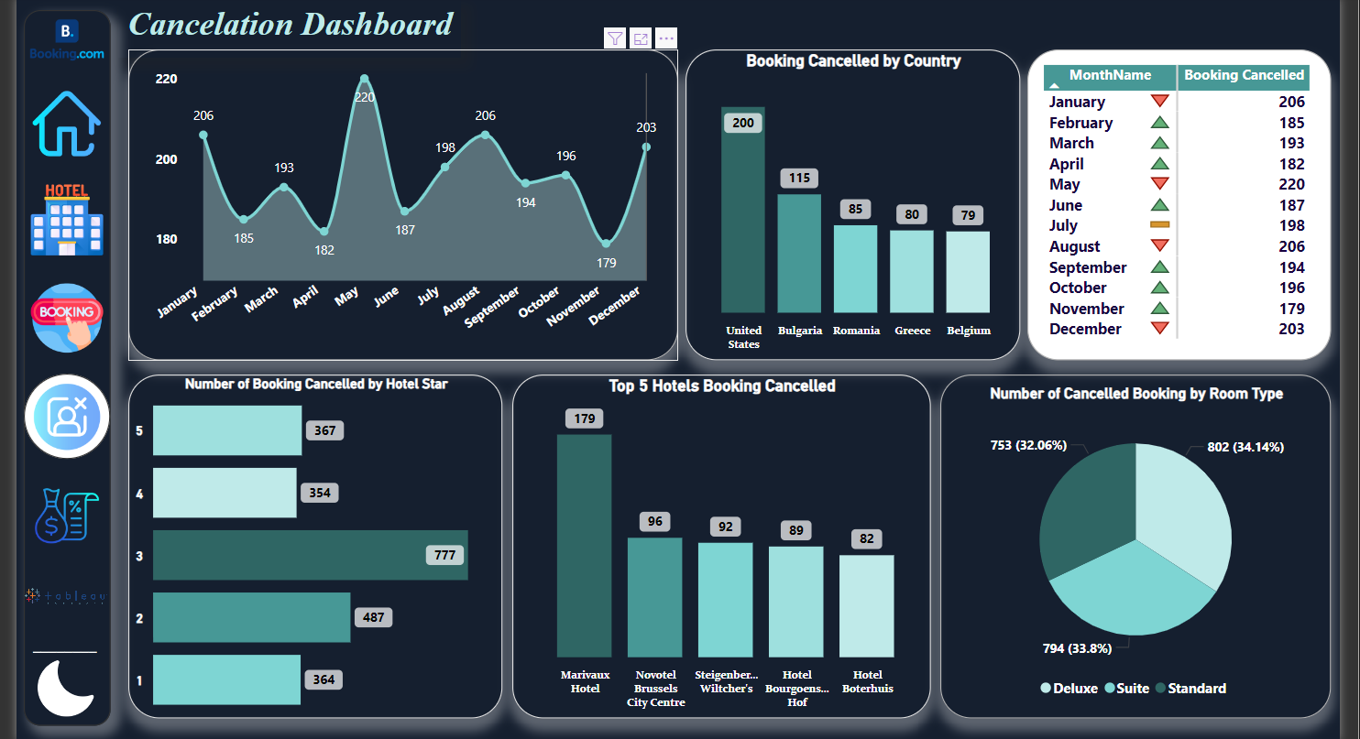
CANCELATION DASHBOARD (DM)
01
FACT
06
07

Slide 32
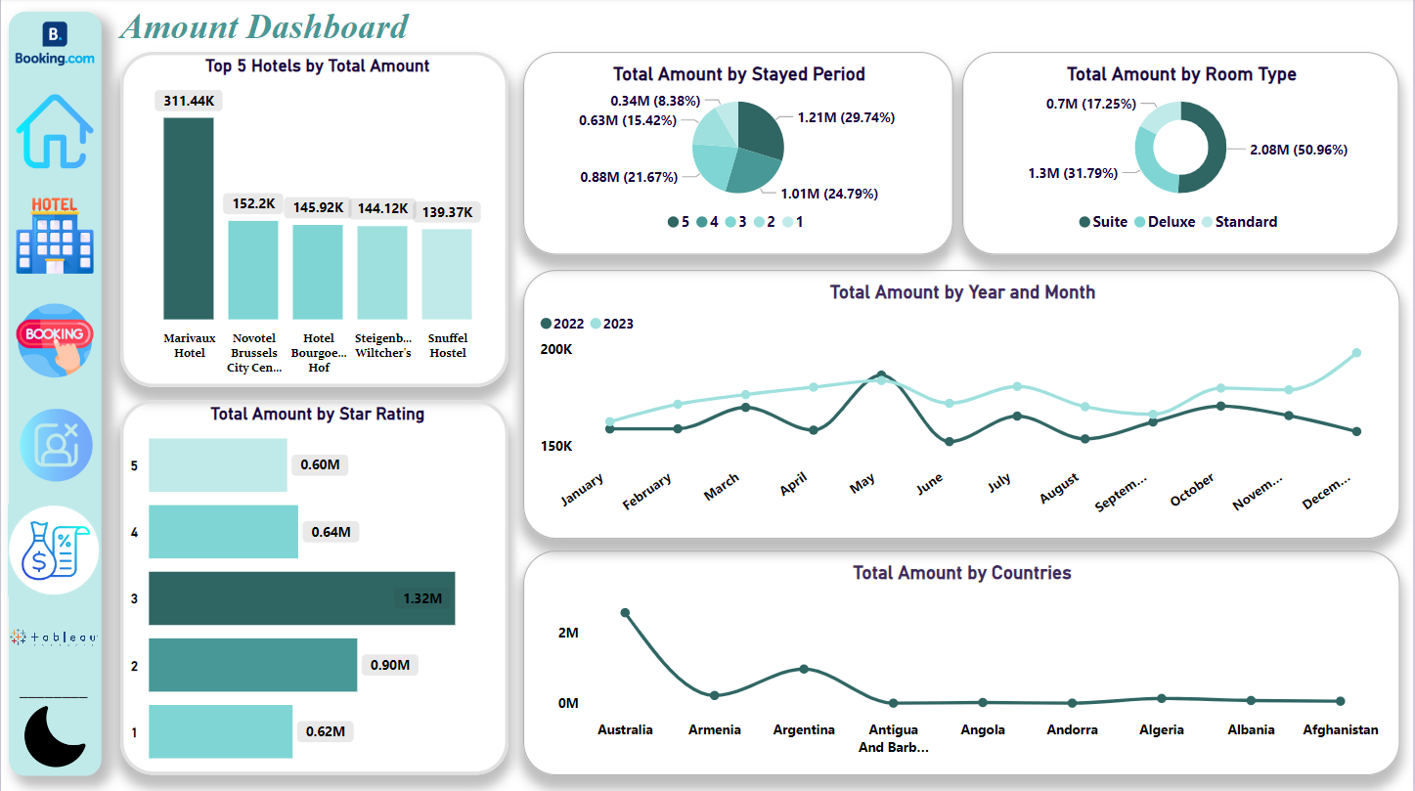
AMOUNT DASHBOARD (LM)
01
FACT
06
07

Slide 33
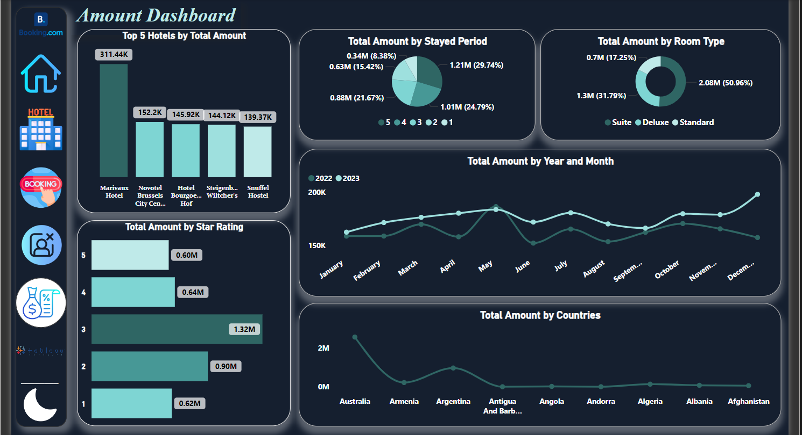
AMOUNT DASHBOARD (DM)
01
FACT
06
07

Slide 34

TABLEAU
created interactive dashboards and visualizations, employing calculated fields and data blending techniques. Enabled insightful data analysis and reporting through dynamic and user-friendly interfaces
01
06
07

Slide 35
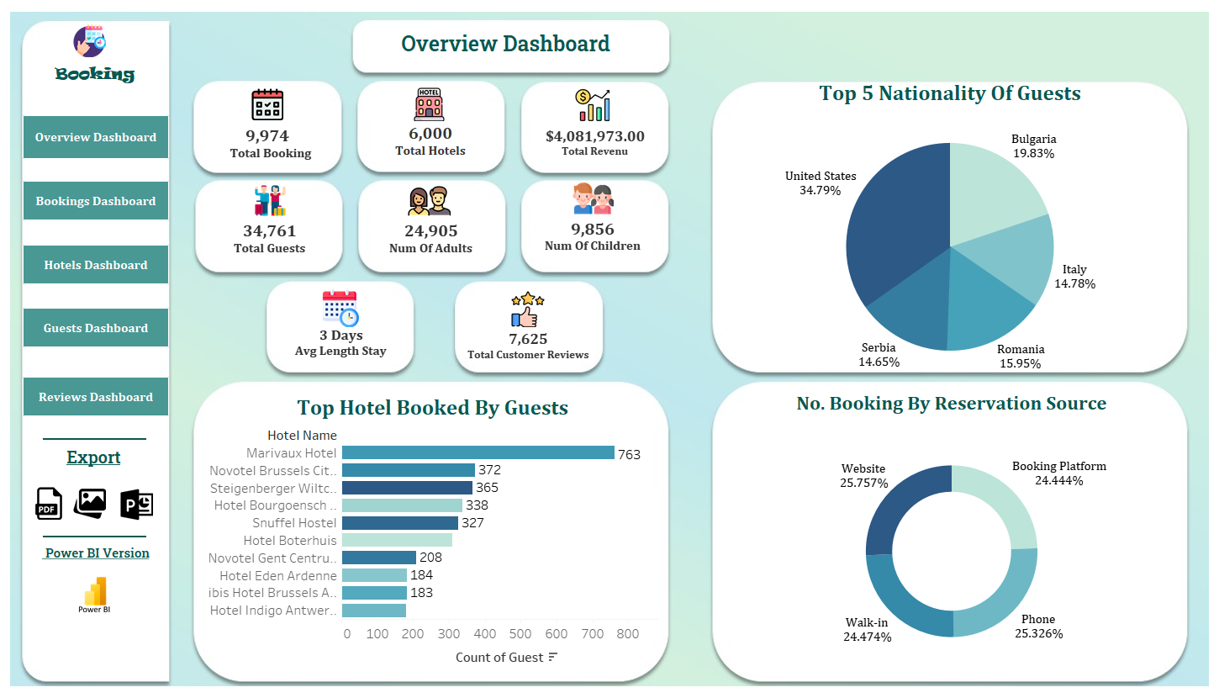
OVERVIEW DASHBOARD
01
FACT
06
07

Slide 36
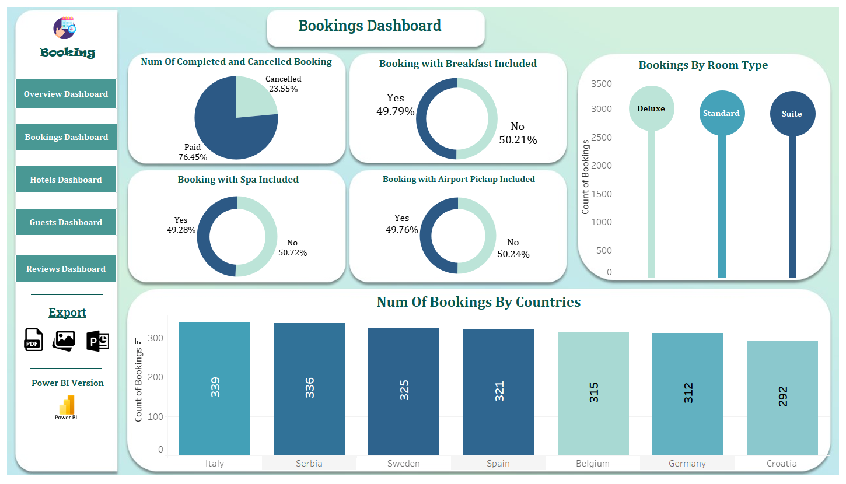
BOOKING DASHBOARD
01
FACT
06
07

Slide 37
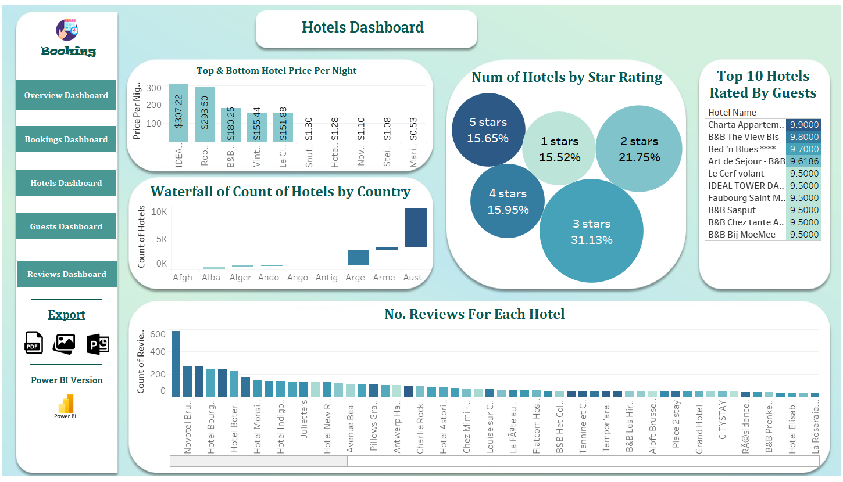
HOTEL DASHBOARD
01
FACT
06
07

Slide 38
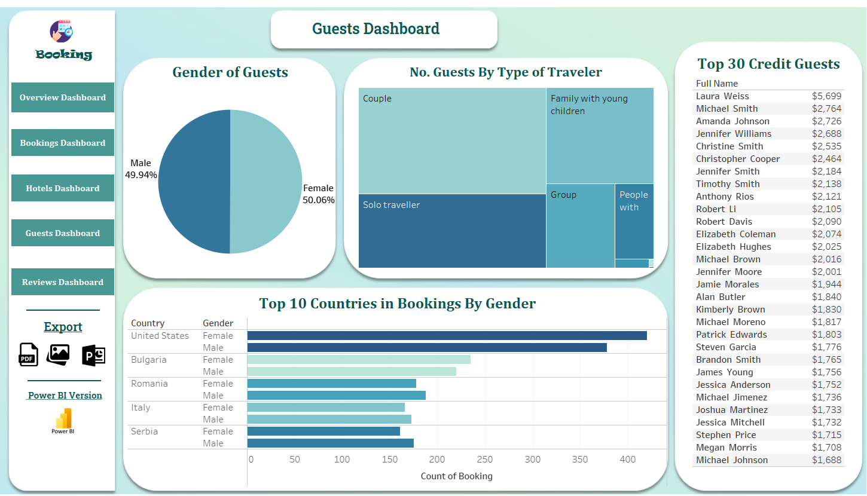
GUEST DASHBOARD
01
FACT
06
07

Slide 39
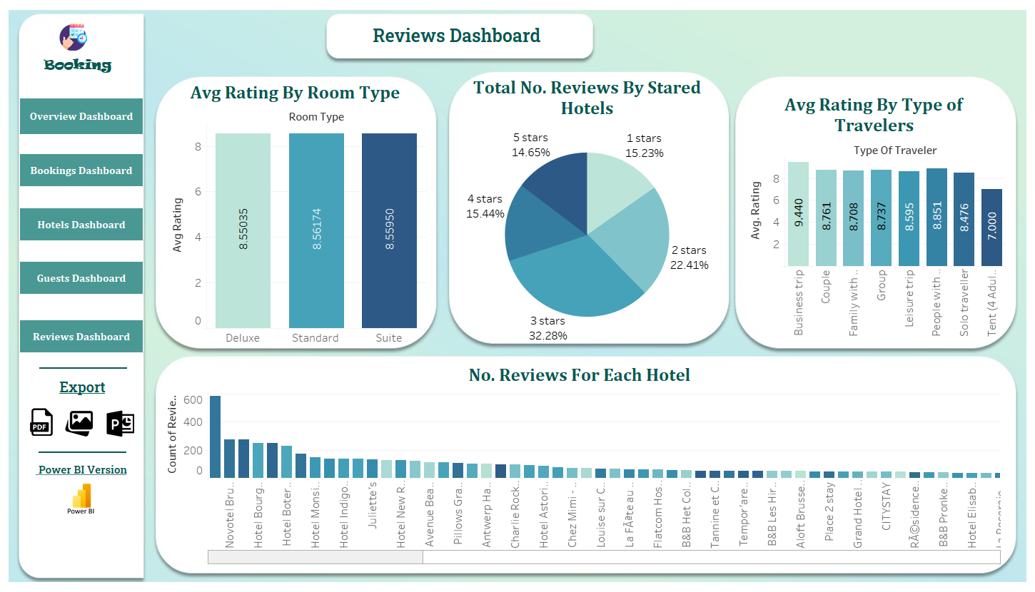
REVIEW DASHBOARD
01
FACT
06
07

Slide 40
Hotels Reservations
Analysis
THANK
YOU

